Slide 1
The Immune System

Slide 2
Pathogens
Pathogens can enter your body in a number of ways
Method of Entry | Examples of Diseases
Food and water | Food poisoning, cholera
Breathing in | Flu, pneumonia, tuberculosis
Cuts and wounds | Tetanus, blood poisoning
Sexual contact | Gonorrhoea, syphilis
Other contact | Anthrax, leprosy

Slide 3
First Line of Defence
The first line of defence is to prevent the pathogens from entering the body.
  Skin is an effective barrier. It protects the internal organs from harmful chemicals and sunlight.
  Fluids such as tears and saliva have antiseptic properties. They wash away dust and harmful substances from openings to the body.

Slide 4
First Line of Defence
  Air entering the nose is filtered by hairs in the nostrils. Some unwanted particles are trapped in the mucous lining of the trachea and are coughed or sneezed out.
  Pathogens entering the digestive system are usually killed by stomach acid. Vomiting and diarrhoea are rapid ways of getting rid of pathogens.

Slide 5
Second Line of Defence
Once a pathogen enters the body tissues, the area becomes red, hot and swollen.
This is called inflammation.
Damaged cells release a chemical to increase blood flow to the area.
In the blood there are white blood cells called neutrophils which consume bacteria.
Dead neutrophils form the pus in infected wounds.

Slide 6
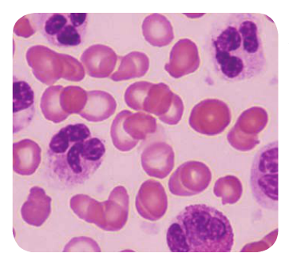

Slide 7
Third Line of Defence
The lymphatic system is a series of vessels that carries fluids from around cells to the heart.
In areas of the lymphatic system there are swellings called lymph nodes.
Lymph nodes contain large numbers of different types of white blood cells called lymphocytes and macrophages.

Slide 8
Macrophages are similar to neutrophils. They consume and destroy pathogens.
Lymphocytes make chemicals called antibodies.
Antibodies cause pathogens to clump together so the macrophages can destroy more pathogens at one time.

Slide 9
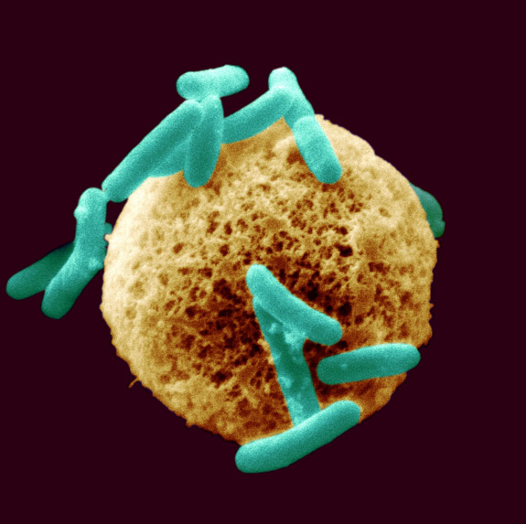

Slide 10
Antibodies
Each pathogen has a specific antibody that acts on it.
The first time the lymphocytes meet a pathogen it takes time to make antibodies. In this time you may get sick.
The next time your immune system meets the same pathogen, it can make antibodies quickly before you become unwell.
You are now immune to the pathogen.

Slide 11
Temperature
To help fight infection, your body temperature rises and you develop a fever.
Pathogens that enter the body function best at normal body temperature.
When you body temperature is higher, the pathogens are not able to function as efficiently so your immune system can fight them more easily.

Slide 12


